Slide 1

Bright Coffee Shop Presentation
Title: Bright Coffee Shop Analysis Dashboard
Subtitle: Powered by SQL, Excel, and Power BI
Presented by: Thamsanqa, Zwane

Slide 2

Executive Summary
Analyzed 6 months of sales data across multiple Lower Manhattan stores
Delivered insights on revenue, customer behavior, product performance, and store comparisons
All values presented in South African Rands (R)

Slide 3
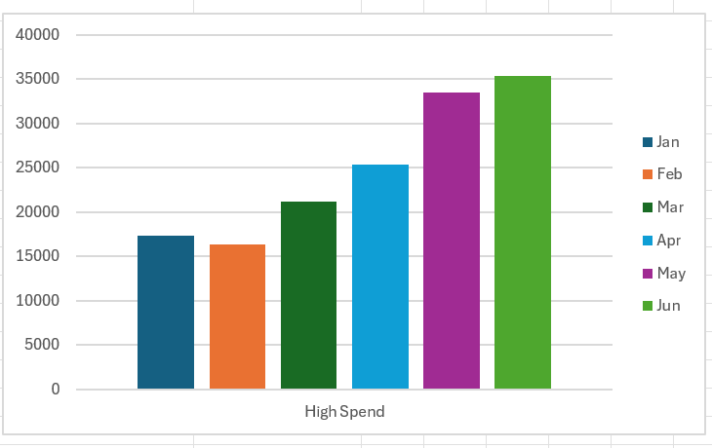
KPI Overview
Details
Overview
Total Revenue: R52,375
Avg Transaction Value: R8.45
Avg Basket Size: 2.5
Number of Sales: 6,195
Visuals:

Slide 4
Recommendations
Expand morning promotions and bundle offers
Replicate product mix in other stores
Focus on high-performing SKUs like Latte and Croissant
Monitor ATV and monthly promotions for optimization

